Slide 1
DNN Comparative Study – Covid X-Ray Dataset
Team:
Micky Kumar Iram Nazir Harold Joseph

Slide 2
Introduction
We aim to examine chest xrays of presumed COVID cases and further classify them as normal pneumonia or true COVID cases.
Open Data
Toronto has released COVID data as an Open data. This data set contains demographic, geographic, and severity information for all confirmed and probable cases reported to and managed by Toronto Public Health since the first case was reported in January 2020. This includes cases that are sporadic (occurring in the community) and outbreak-associated. The data are extracted from the provincial communicable disease reporting system (iPHIS) and Toronto's custom COVID-19 case management system (CORES) and combined for reporting. Each line summarizes information for an individual case.

Slide 3
Selection of models. But first, the inspiration.
Regions of the brain involved in image recognition.
V1 (Primary visual cortex) – What is important in the global picture to guide the shift of attention.
Importance to simple properties such as orientation, spatial frequency, colour.
V2 (Secondary visual cortex) – Strong feedback connection to V1. Sends strong connections to V3,4,5.
Role in object recognition memory.
V3 Role in global motion.
V4 Role in encoding stimulus salience, gated by signals coming frontal eye fields, shows changes in spatial profile with attention.
V5 Role in motion perception.

Slide 4
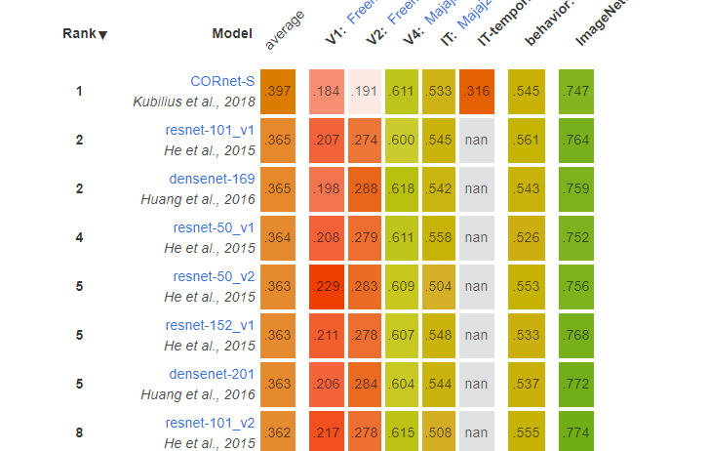
Selection of models

Slide 5
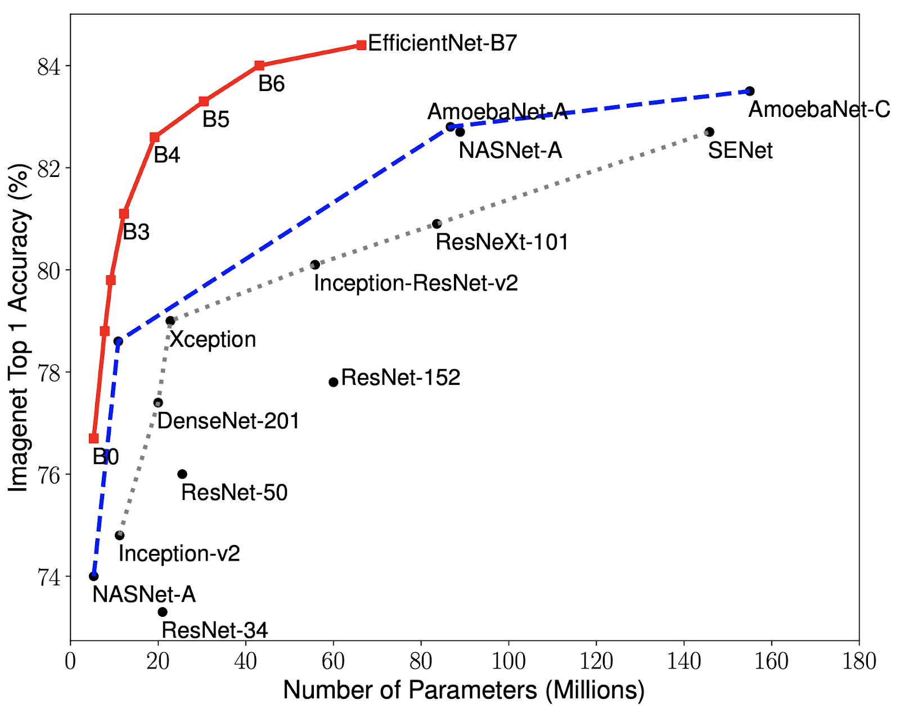
Transfer Learning –Ranking of various Models on ImageNet Dataset

Slide 6
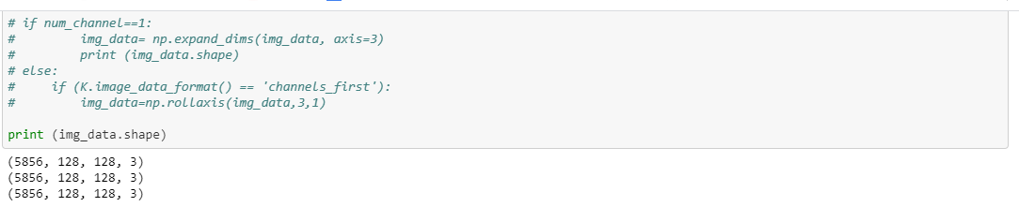
Classes and shape for X-ray images
names = ['normal','pneumonia']

Slide 7
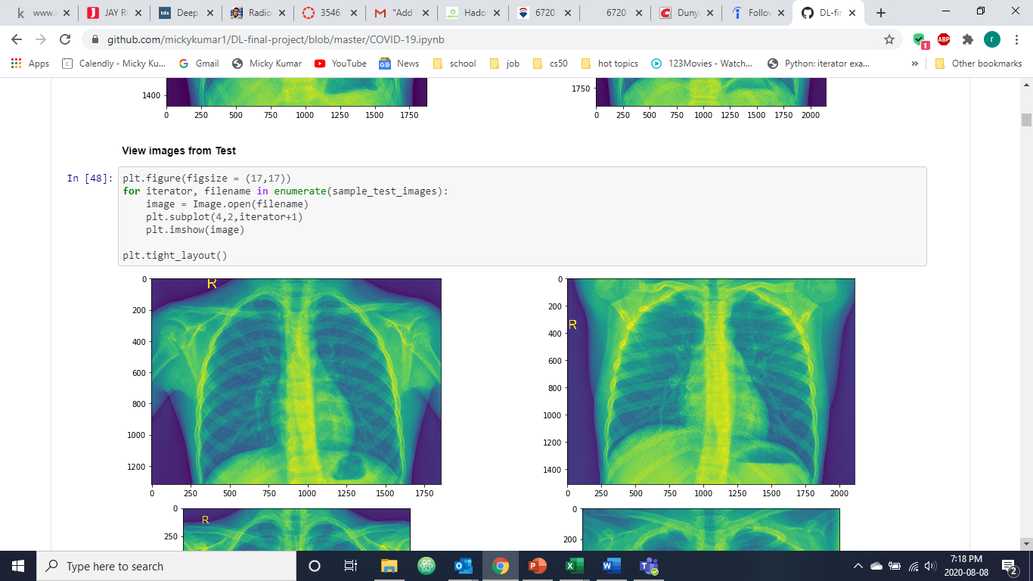
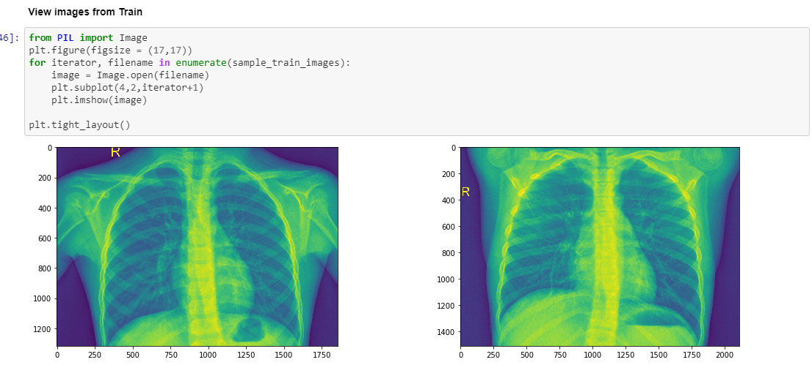
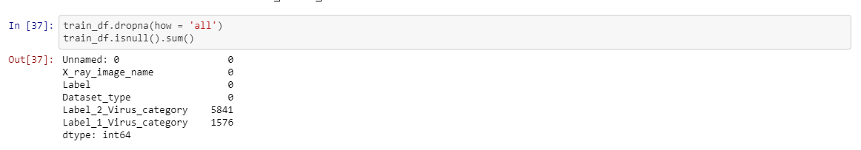

Slide 8
Image Classification Models Studied
VGG19
MobileNetV2
InceptionV3
ResNet50
EfficientNetB0

Slide 9
VGG19
Number of Epochs 300
Loss Function: Categorical Cross Entropy, Optimizer: Adam & Metric: Accuracy
Total params: 143,669,242, Trainable params: 2,002, Non-trainable params: 143,667,240
Training time: 3709s
loss=0.1818, accuracy: 93.1741%

Slide 10
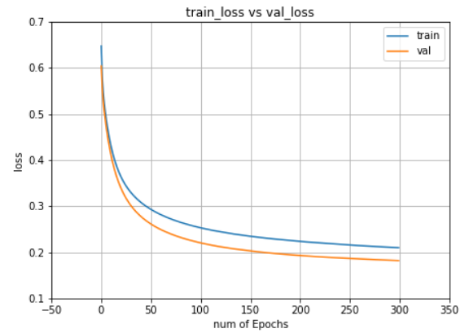
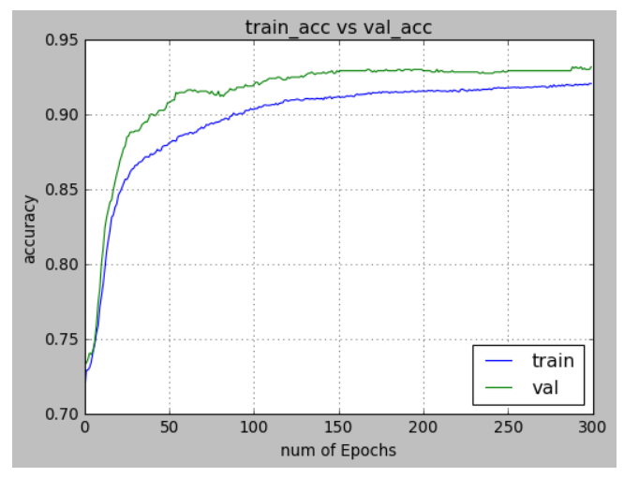
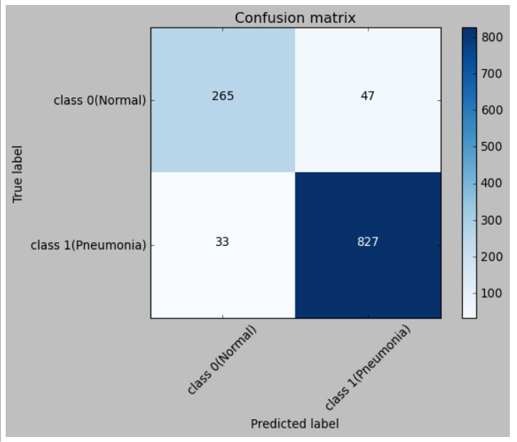
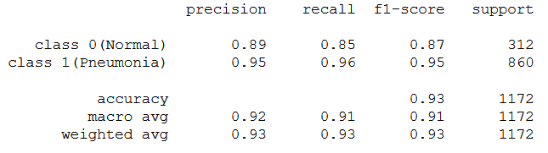
VGG19 - Report

Slide 11
MobileNetV2
Number of Epochs 100
Loss Function: Categorical Cross Entropy, Optimizer: Adam & Metric: Accuracy
Total params: 3,540,986, Trainable params: 3,506,874, Non-trainable params: 34,112
Training time: 609.81s
loss=0.2416, accuracy: 91.4676%

Slide 12
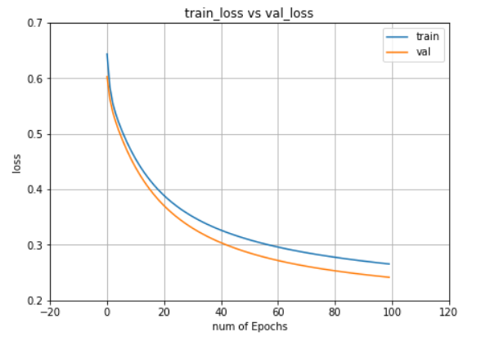
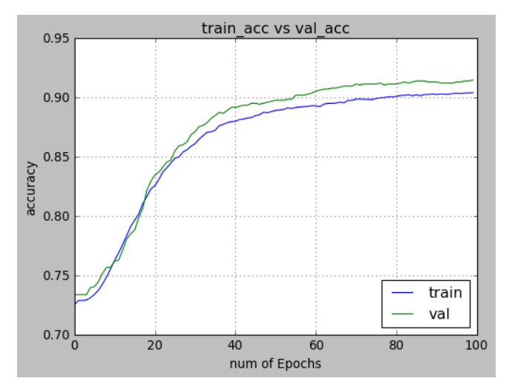
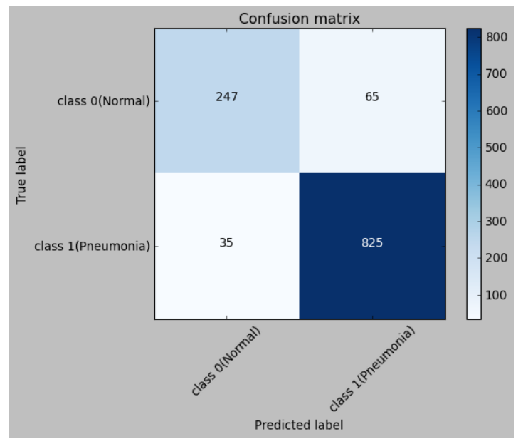
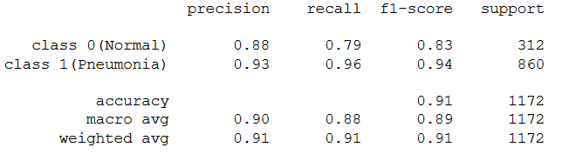
MobileNetV2 - Report

Slide 13
Inception V3
Number of Epochs 100
Loss Function: Categorical Cross Entropy, Optimizer: Adam & Metric: Accuracy
Total params: 21,806,882, Trainable params: 4,098, Non-trainable params: 21,802,784
Training time: 868.8s
loss=0.9426, accuracy: 90.4437%

Slide 14
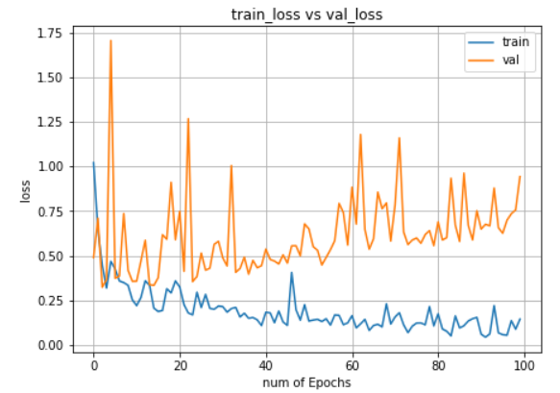
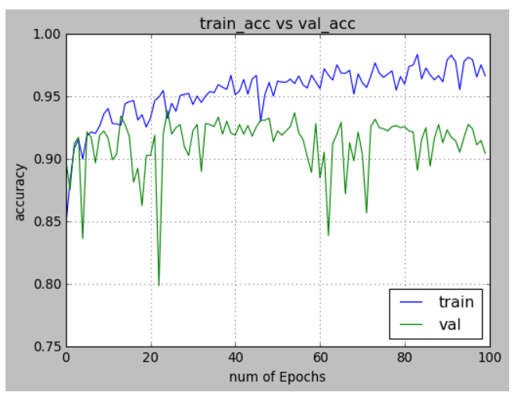
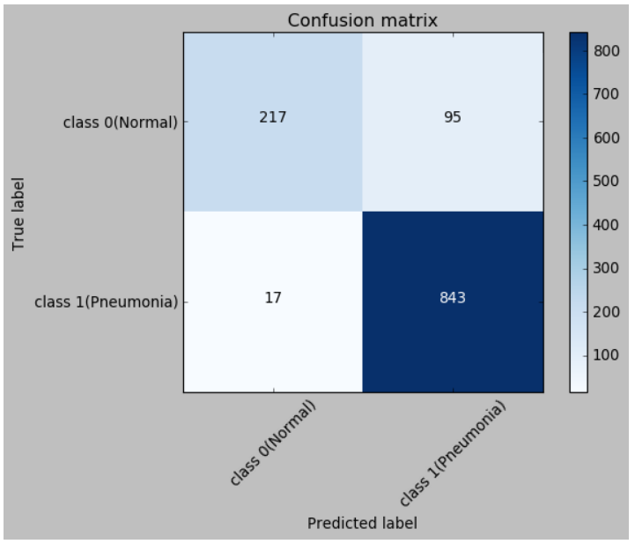
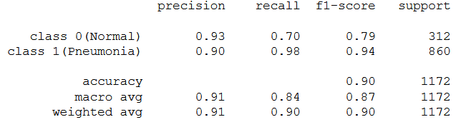
Inception V3 - Report

Slide 15
ResNet50
Number of Epochs 100
Loss Function: Categorical Cross Entropy, Optimizer: Adam & Metric: Accuracy
Total params: 23,591,810, Trainable params: 4,098, Non-trainable params: 23,587,712
Training time: 975.8s
loss=0.1323, accuracy: 97.4403%

Slide 16
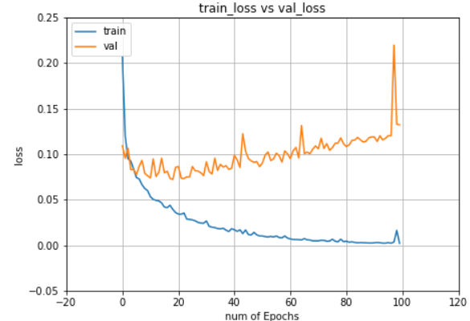
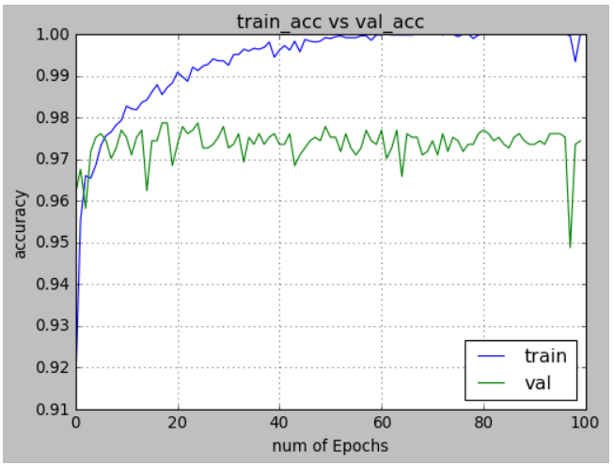
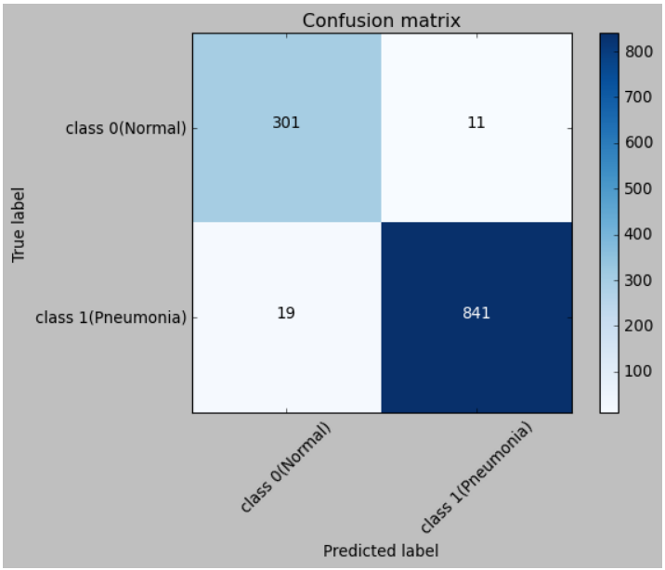
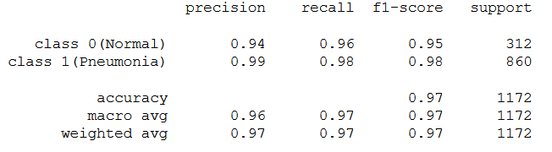
ResNet50 - Report

Slide 17
EfficientNetB0
Number of Epochs 100
Loss Function: Categorical Cross Entropy, Optimizer: Adam & Metric: Accuracy
Total params: 4,052,133, Trainable params: 2,562, Non-trainable params: 4,049,571
Training time: 848.4s
loss=0.0901, accuracy: 96.9283%

Slide 18
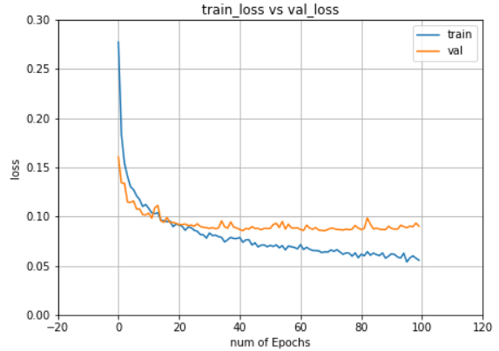
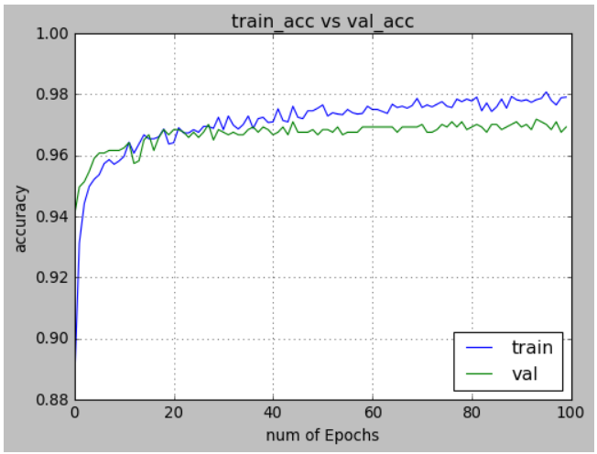
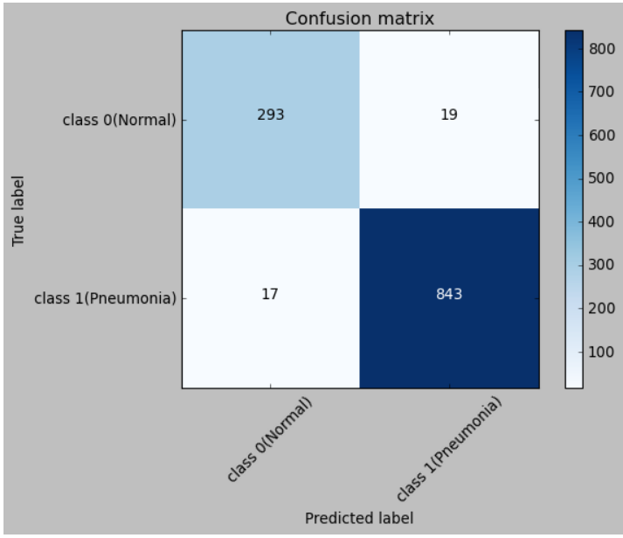
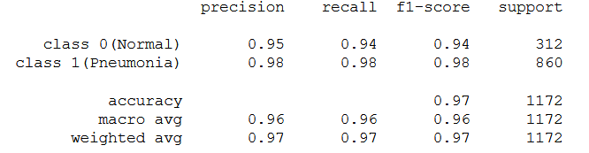
EfficientNetB0 - Report

Slide 19
Comparison Chart

Slide 20
Conclusion and Inference
ResNet
EfficientNetB0
VGG19
MobileNetV2
InceptionV3
Accuracy vs No of Params
ResNet Model has the highest validation accuracy, but the number of parameters are large and also has big model size
EfficientNet Model has good accuracy, fewer number of parameters, small model and lowest loss

Slide 21
Code and Repository
https://github.com/mickykumar1/DL-final-project

Slide 22
References
https://github.com/ieee8023/covid-chestxray-dataset
https://keras.io/api/applications/
https://keras.io/guides/transfer_learning/
https://ai.googleblog.com/2019/05/efficientnet-improving-accuracy-and.html
https://medium.com/@mahakkothari190.mk/comparison-of-different-deep-learning-models-for-image-classification-1c49f1159d7a

Slide 23
Thank You

